Slide 1


Autism diagnosis ML Model based on Eye movement Tracking
Crystal Rubalcava
TRGN515 Spring 2023
https://autismsociety.org/autism-acceptance-month/

Slide 2
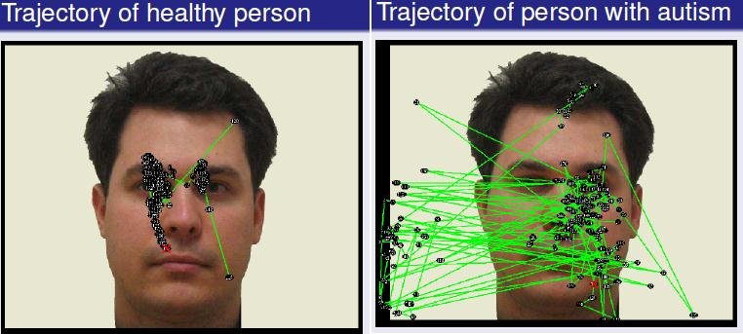

OVERALL goal
The overall goal was to providing an eye-tracking data set for researchers of autism in hopes of developing diagnostic models that can help detect autism at an early stage of childhood development.
Eye tracking and visual movement can help explain brain functions and cognitive levels. With this, I will be using a subset of this dataset to showcase my work in trying to determine how eye-tracking could be used to diagnose autism in young children.
https://www.researchgate.net/publication/340284642
Notes:
https://www.cdc.gov/mmwr/volumes/72/ss/ss7202a1.htm?s_cid=ss7202a1_w
* This dataset is an eye-tracking dataset that was developed for the purpose of autism diagnosis from a group at Université de Picardie Jules Verne. Eye-tracking methods are used as a sign of autism where abnormalities of the eye gaze are largely recognised as the hallmark of autism [3](https://figshare.com/articles/dataset/Eye-Tracking_Dataset_to_Support_the_Research_on_Autism_Spectrum_Disorder/20113592). The group published this dataset in hopes of contributing to the scarces health data available for programs in artificial intelligence and machine learning. The overall goal of this dataset was to providing an eye-tracking data set for researchers of ASD in hopes of developing diagnostic models that can help detect autism at an early stage of childhood development.
* I will be using a subset this dataset to showcase my work in trying to determine how eye-tracking could be used to diagnose autism at an earlier age. I used jupter notebook to do this project.

Slide 3
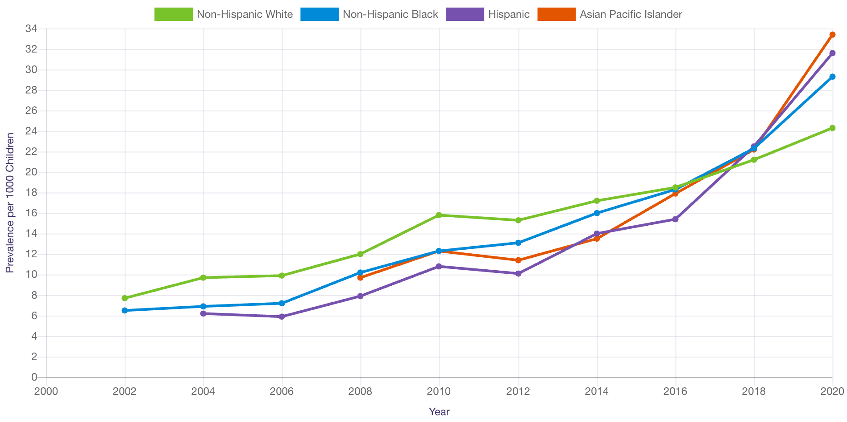
https://www.cdc.gov/ncbddd/autism/data/index.html
Notes:
Autism spectrum disorder (ASD) is a neurodevelopmental disability in folks often affecting social communication and interaction, and restricted or repetitive behaviors or interests in folks. This graph found on the CDC website shows the prevalence of ASD diagnosis since 2002.
I’ve worked with children with disabilities my whole life. I volunteered in a special day centers when I was in middle and high school and worked as a teachers aid in special education classes in undergrad. Over the years, I’ve seen many families have a hard time finding the resources to get their child a diagnosis that would ultimately help them get the services they need.
I’ve heard about eye tracking in ADHD studies and was curious to see how this could be replicated in other neurodivergent children.

Slide 4
Summary of study
Eye-Tracking Dataset to Support the Research on Autism Spectrum Disorder
59 school aged children from region of Hauts de France
Age range from 3 to 12 years old
Split between children that have autism and those that are labeled as typically developing
25 separate, single eye tracking experiments tracked on separate csv-formatted files
Due to the size of the data, in this presentation, we will be looking at CSV #1 of the list
Each participant’s study duration was ~5 minutes
Multiple participants were seen per each session
Data Set Characteristics: | Multivariate | Number of files in public dataset: | 25 CSV | Area of Sudy: | Autism Research
Dtype: | Int64, float64, object | Number of Instances in CSV #1 (including NULL): | 34,3630 | Dataset posted: | 2022-06-21
Count of participants in the study (Female, Male) | 16 (7,9) | Number of Data Points in CSV#1 Missing Values (NULL values removed): | 29,847 | Location: | Hauste de France

Slide 5
Important terms
Fixation
Saccade
Blinks
Point of Regard
Pupil Diameter
AOI (Area of Interet)
https://eyeware.tech/blog/what-is-eye-tracking/.
Notes:
Eye Tracking: Eye tracking enables the measurement of eye movements, eye positions, and points of gaze through various technological processes. In other words, eye tracking identifies and monitors a person’s visual attention in terms of location, objects, and duration.
Fixation: occur when the eye stops to collect visual data. Although the duration of one is highly variable, the longer a fixation is, the more visual information is processed.
Saccade: are fast “jumps” that the eye performs between fixations in a static environment. The eye moves from one object of interest to another with the goal of acquiring new visual data in high resolution. Due to the extreme speed of saccades, vision is suppressed. Thus, they are not as significant in gaze tracking as fixations are. Yet, they do reveal information about the course of fixations and visual attention.
Blinks: occur
Point of Regard (POG): also referred to as Gaze points show what the eyes are looking at. Is measured on both X and Y axis
Pupil diameter: tracks Pupil Size, video-based gaze tracking allows the measurement and analysis of pupil size. To get accurate pupil tracking data, the environment needs to be rigorously controlled.
Inadequate test conditions, pupil dilation can be observed and monitored as a result of:
Strong emotional stimuli
Acute attention
Illumination
Working memory load
AOI Area of Interest: To assess different fixation metrics, areas of interest (AOIs) are used to select specific regions in a scene. IN this scenario it was a balloon with different colors.

Slide 6
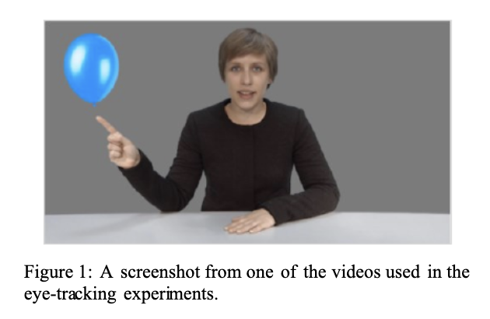
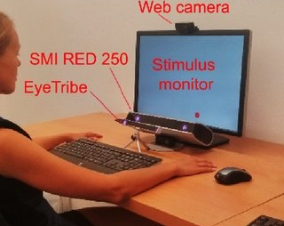
Eye tracking
Screenshot from study paper
Example of experiment set up
https://eyeware.tech/blog/what-is-eye-tracking/.
Notes:
Eye Tracking: Eye tracking enables the measurement of eye movements, eye positions, and points of gaze through various technological processes. Following the calculation of a gaze point, the raw data appears in the form of an XY coordinate. The XY coordinate indicates where a participant is looking on the screen. Then, the gaze tracking outputs coordinates according to its frame rate speed.
Fixation: occur when the eye stops to collect visual data. Although the duration of one is highly variable, the longer a fixation is, the more visual information is processed.
Saccade: are fast “jumps” that the eye performs between fixations in a static environment. The eye moves from one object of interest to another with the goal of acquiring new visual data in high resolution. Due to the extreme speed of saccades, vision is suppressed. Thus, they are not as significant in gaze tracking as fixations are. Yet, they do reveal information about the course of fixations and visual attention.
Blinks: occurwhen
Software tools are typically used for eye tracking and processing data, namely identifying fixations and saccades. Fixations often show up as dots with sizes corresponding to the duration of the movement. Saccades are the lines that connect the fixation-dots.
These actions can help clean the raw data before generating visualizations:
Reduce noise density
Improve precision
Apply an eye movement classification algorithm
In this experiment, students were 60 cm away from the monitor in a quiet room in the university with barriers around them to prevent visual distractions

Slide 7
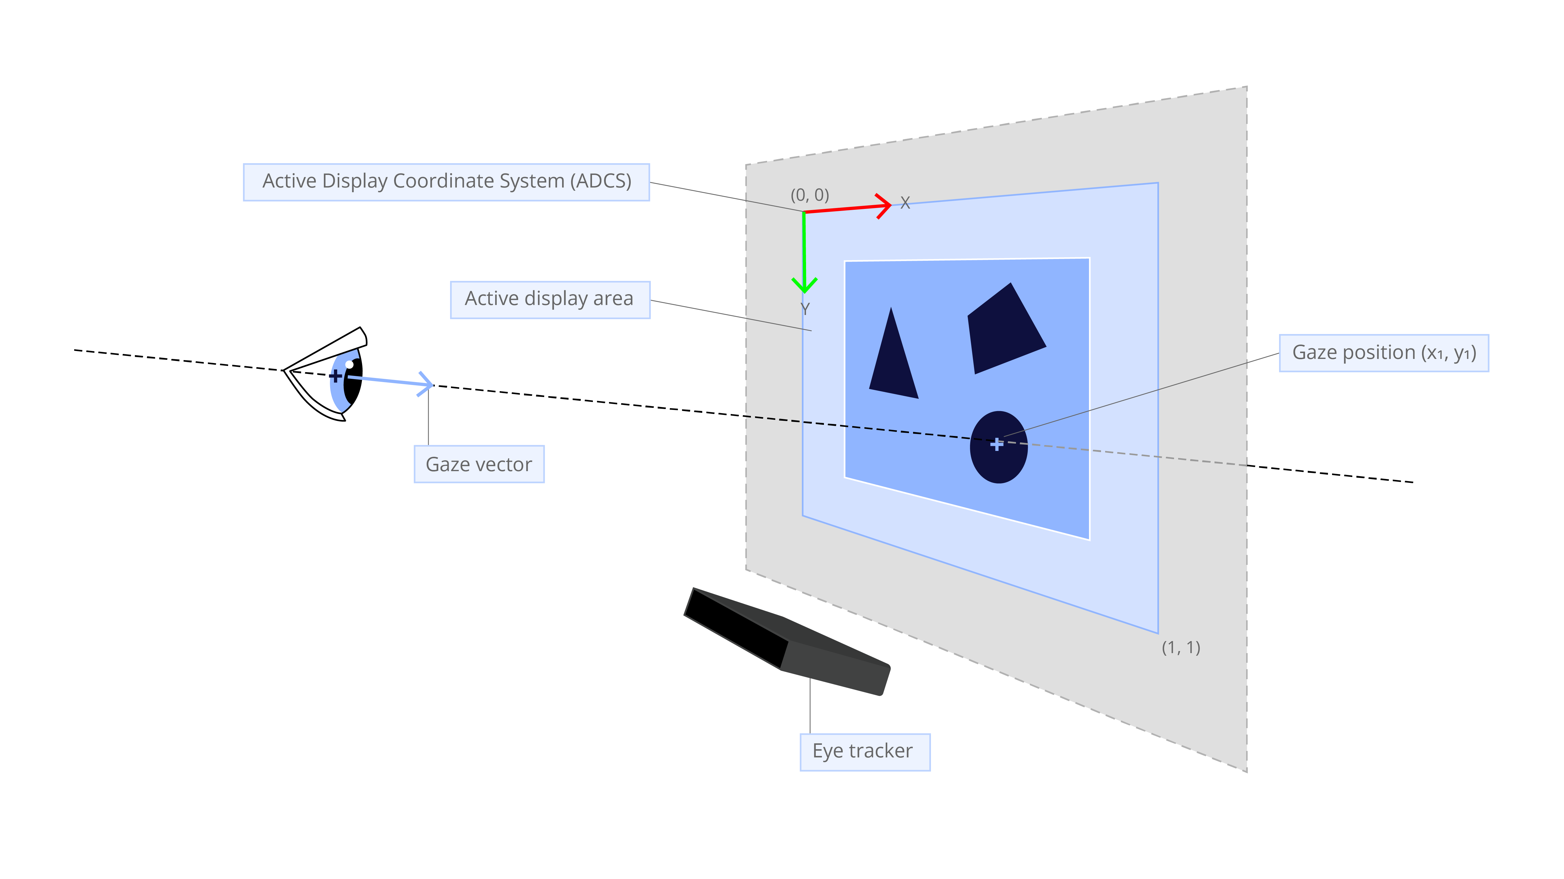
Notes:
Example of how gaze point is calculated and tracked using the system
- Px is based on the pixel size of the screen video 1280X1024 for this study display resolution is usually used to mean pixel dimensions, the maximum number of pixels in each dimension

Slide 8
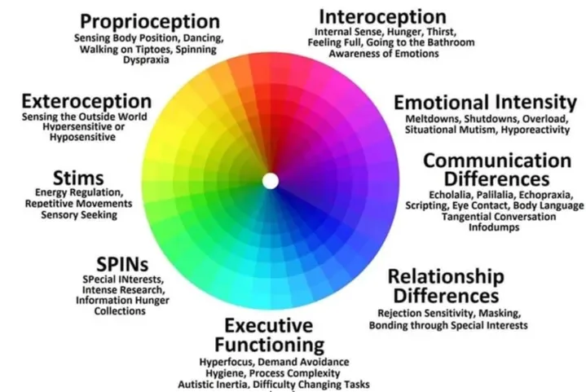
Autism spectrum disorder
https://www.crossrivertherapy.com/autism/wheel
Notes:
Autism Spectrum Disorder (ASD): Neurodevelopmental disorder often affecting social communication and interaction, and restricted or repetitive behaviors or interests in folks.
Typically developing (TD): the process of neural development continues across a predictable pattern common to most children the same age

Slide 9
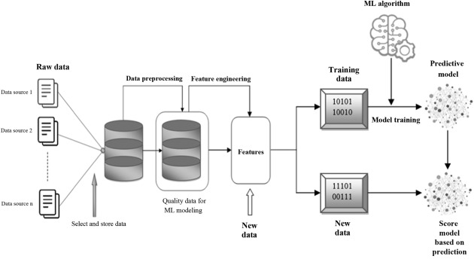
Machine learning RECAP
Split Train and Test Data
Testing data
https://www.sciencedirect.com/science/article/abs/pii/B9780128212295000057
Notes:
We are at the step of identifying our raw data. A brief summary of how a a machine learning model works is it that it is a branch of artificial intelligence (AI) that enables computers to “self-learn” from training data and improve over time, without being explicitly programmed. These ML models are able to detect patterns in data and learn from them, in order to make their own predictions.
The goal of using this dataset is to try and use the eye tracking data to build a model to that can guess the diagnosis of the participant. We are using a pretty big dataset with thousands of eye tracking datapoints but it is not big in the sense of many participants. We will see how this affects the quality of the model in later slides.

Slide 10
Features and Types of Features
Data
Categorical (qualitative)
Numerical (quantitative)
Ordinal
Discrete
Continuous
Nominal
Ordinal: Logical order or ranking
Nominal: No logic order or rank
Continuous: Each value is distinct
Discrete: Each value has a next or previous value
Target
Binary classification of 1) typically developing (TD) or 2) autism spectrum disorder (ASD)
Class: Categorical data type
Notes:
We start with our data set that contains 41 features, identify our target and label the features as categorical or numerical. For this dataset, we have a combination of nominal, ordinal categorical data and continuous and discrete numerical data. We will not use all these feature types and in the next slides I’ll show how I decided to remove some of these.

Slide 11
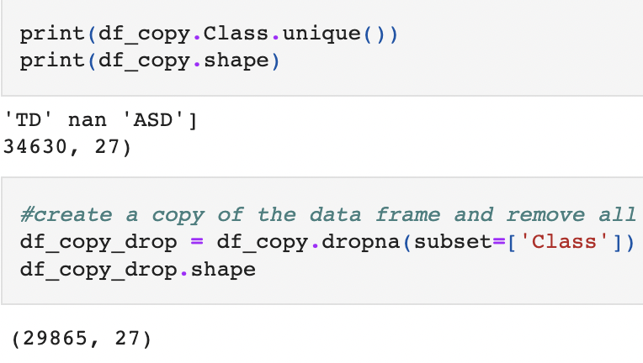
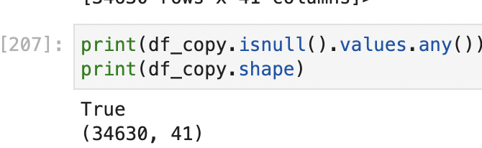
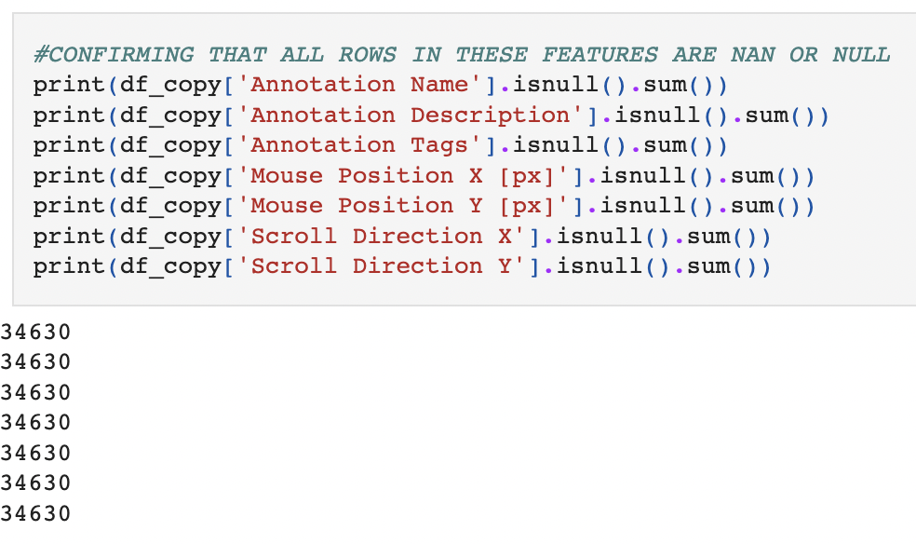
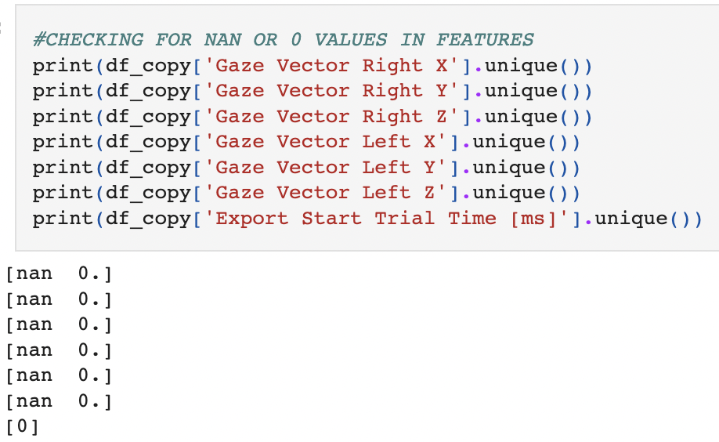
MISSING DATA DROPPED
Notes:
I have 41 columns in this dataset and not all are needed or useful to this project. In order to clean up this dataset I dropped columns that do not have values as they are columns that are not useful to us.
I decided to drop the following columns from the data that were not useful to me and did not have any values for which I could possibly replace the NULL values with a mean or median.

Slide 12
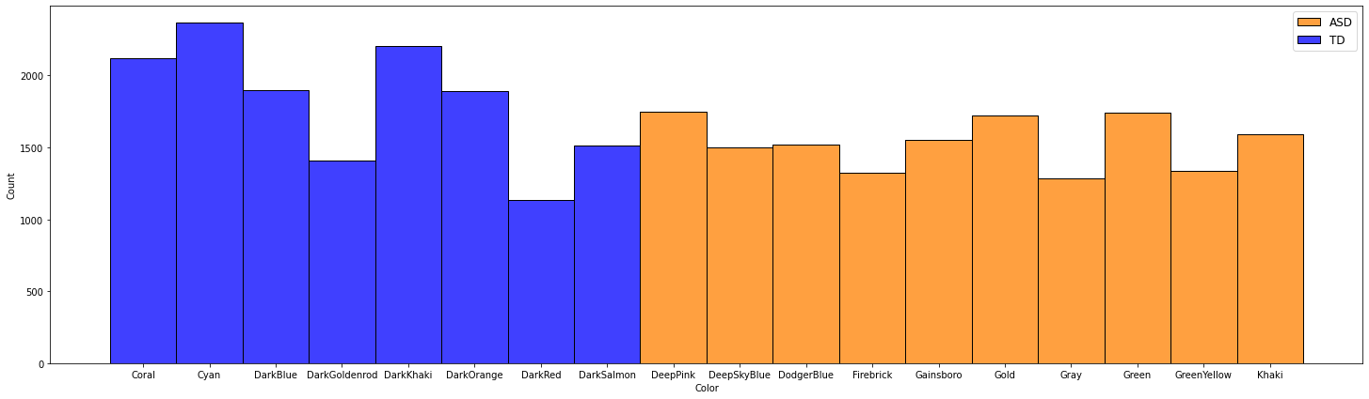
Color of balloon
Notes:
After dropping 14 features, I wanted to look more closely into other features that I thought could be of relevance. In this slide, you’ll see that the experiement tracked the color of the balloon that was present on the screen for each session. The color of balloon was not consistent throughout the participants of this round of the experiment so it was dropped because it would be skewed data since we do not know how a kid with ASD would react to a Coral balloon if they were not presented it.

Slide 13
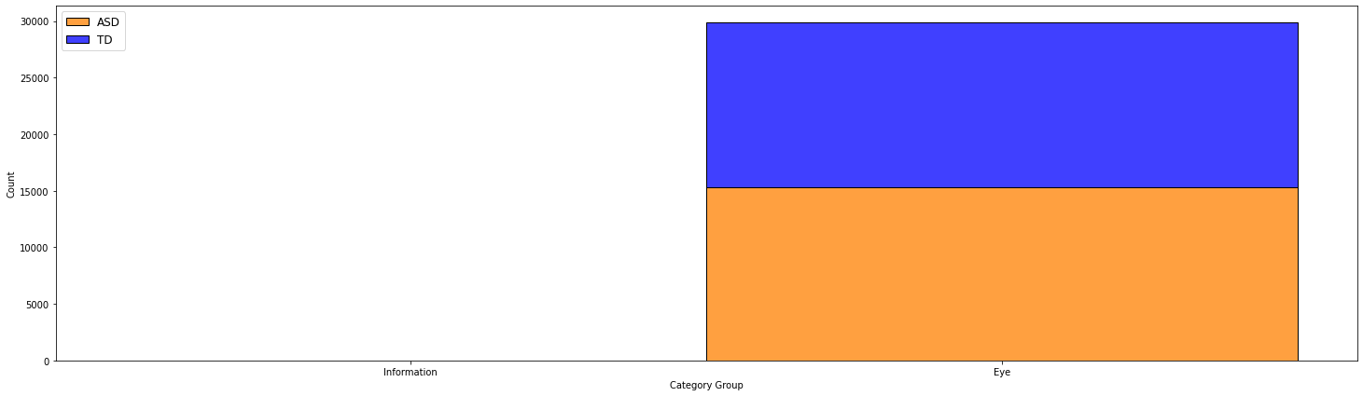
Category Group
Notes:
I thought the category group might be interesting but soon realized that the category group only this dataset contained was ‘eye’ because this dataset looked at eye tracking. The information category was there to include notes the investigators took during the experiment but there were no relevant notes in this subset of data so I decided to drop it.

Slide 14
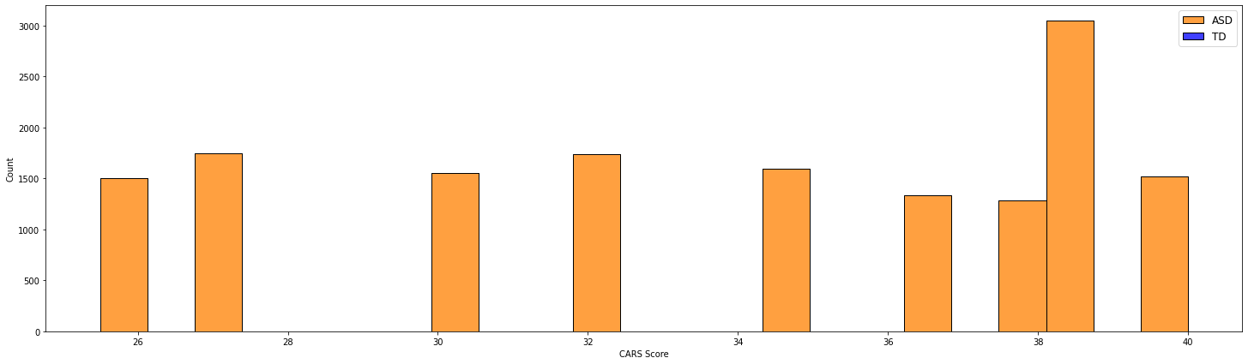
CARS Score Feature
CARS Score: Childhood Autism Rating Scale established in 1988 ranging from 15-60. Scores below 30 are considered non-autistic, scores from 30-36/5 are mild/moderate autism and above 37 is considered severe autism
https://pubmed.ncbi.nlm.nih.gov/2273011/
Notes:
Now for the CARS score feature, this is a feature that I thought I was initially going to keep in the model because this score was initiallyused to diagnose the participants that have Autism in this study. After some review, I found it would be best to remove completely. Let me explain.
The CARS score stands for Childhood Autism Rating Scale. It was established in 1988 ranging from 15-60. Scores below 30 are considered non-autistic, scores from 30-36/5 are mild/moderate autism and above 37 is considered severe autism. So this feature would be definitely correlated to the diagnosis of the participant. However, only students that had gotten tested for Autism would have a score and others would be blank. We in fact, don’t know what the other children would score on the CAR Scale. This would be a great target variable for a different model. For this case, I am only using the binary classification of ASD and TD so I removed this instead of replacing the missing variables with the mean or median.

Slide 15
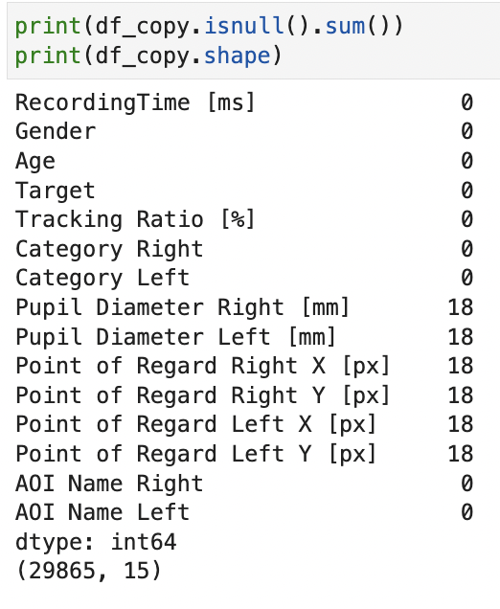
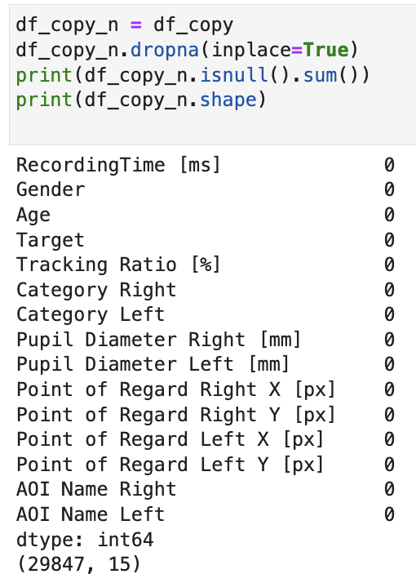
Null DATA DROPPED
Drop NaN values as they make up less than 1% of the total dataset (0.06%)
Creates a more robust model
Notes:
There were also some other features that didn’t have any useful data – Row, Stimulus, Contact, Index was removed because I didn’t know what the dataset was referring to regarding index values, participant, and time fields since we have the total recording time of each session.
I ran the .isnull function again and I noticed even after dropped the columns that had NULL values, I could still see that there were a few lingering null values.
Because our dataframe has many values, we can choose to drop all rows with NULL values since the 18 identified above only make up less than 1% of the dataframe.

Slide 16
Features in the dataset
Features | Descriptions | Types
Recording Time [ms] | Recording time of session in milliseconds | Continuous
Color | Color of balloon stimulus in drop video | Categorical
Gender | Gender of participant monitored | Categorical
Age | Age of participant monitored | Continuous
TARGET | Binary classification of 1) typically developing (TD) or 2) autism spectrum disorder (ASD) | Categorical
CARS Score | Scale that classified the severity of autism diagnosis (0-60) | Continuous
Tracking Ratio | Ratio of eye tracking movements per references point of regard (gaze point) | Continuous
AOI Name Right and Left | Accesses fixation metrics using regions on screen | Categorical
Category Right | Right eye movement category : Blink, Fixation, Saccade, Separator | Categorical
Category Left | Left eye movement category: Blink, Fixation, Saccade, Separator | Categorical
Pupil Diameter Right [mm] | Diameter of right pupil | Continuous
Pupil Diameter Left [mm] | Diameter of left pupil | Continuous
Point of Regard Right X [px] | Gaze point of the right eye | Continuous
Point of Regard Right Y [px] | Gaze point of the right eye | Continuous
Point of Regard Left X [px] | Gaze point of the left eye | Continuous
Point of Regard Left Y [px] | Gaze point of the left eye | Continuous
Notes:
So the features I was left to work with are listed above. A brief description of some of these are:
Tracking ratio: eye tracking movements per references at each point of regard OR gaze point
Point of Regard (POG): also referred to as Gaze points show what the eyes are looking at. Is measured in pixels on both X and Y axis of the screen. The screen resolution was 1280x1024 on a 17in monitor.
Pupil diameter: tracks Pupil Size, video-based gaze tracking allows the measurement and analysis of pupil size. To get accurate pupil tracking data, the environment needs to be rigorously controlled.
Inadequate test conditions, pupil dilation can be observed and monitored as a result of:
Strong emotional stimuli
Acute attention
Illumination
Working memory load
AOI Area of Interest: To assess different fixation metrics, areas of interest (AOIs) are used to select specific regions in a scene. IN this scenario it was a balloon with different colors.

Slide 17
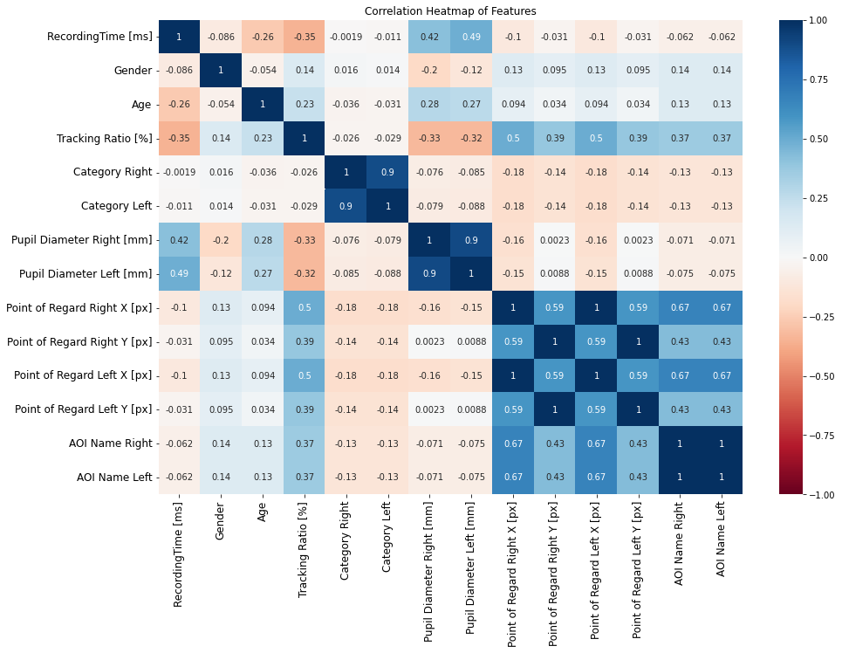
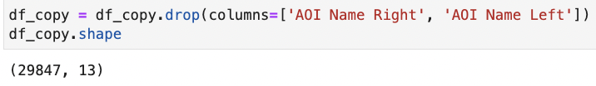
Correlation Heatmap of features
Decided to remove AOI Name Features as they are all linearly correlated
Category R/L and Pupil Diameter R/L are also highly correlated, but they are also important features in eye tracking
12 features left in selection
Notes:
Quick Note: I did not fill the '-' in Category R/L feature with any data. This feature is a categorical feature containing 3 different eye tracking categories. The. '-' indicated that the experiment did not or could not categorize the eye movement. There were cases where one eye did have movement and it was tracked and the other did not. I decided it was best to not categorize the missing data into an existing eye movement category and instead categorize the non-tracked movement as its own category = 0.
* Fixation:Fixation: occur when the eye stops to collect visual data. Although the duration of one is highly variable, the longer a fixation is, the more visual information is processed.
* Blink: occur rapidly and involuntarily as a result of shutting and opening the eyelids
* Saccade: are fast “jumps” that the eye performs between fixations in a static environment. The eye moves from one object of interest to another with the goal of acquiring new visual data in high resolution. Due to the extreme speed of saccades, vision is suppressed but they do reveal information about the course of fixations and visual attention.

Slide 18
Final Feature Selection
Features | Descriptions | Types
Category Right | Right eye movement category : Blink Fixation, Saccade, - | Categorical
Category Left | Left eye movement category : Blink, Fixation Saccade, - | Categorical
Gender | Male and Female | Categorical
Age | Min: 3.2 years, Max: 12.3 | Continuous
Pupil Diameter Right [mm] | Diameter of right pupil | Continuous
Pupil Diameter Left [mm] | Diameter of left pupil | Continuous
Point of Regard Right X [px] | Gaze point of the right eye | Continuous
Point of Regard Right Y [px] | Gaze point of the right eye | Continuous
Point of Regard Left X [px] | Gaze point of the left eye | Continuous
Point of Regard Left Y [px] | Gaze point of the left eye | Continuous
Tracking Ratio | Ratio of eye tracking movements per references gaze point | Continuous
RecordingTime [ms] | Total time of eye tracking session | Continuous
Notes:
After cleaning it up this is how it looks like. We have 3 categorical features and 9 continuous features.

Slide 19
Categorical Features
Symbol | Numeric Conversion in Table | Definition | Feature
M | 0 | Male | Gender
F | 1 | Female | Gender
Separator | 0 | No specific eye tracking term determined | Category R/L
Fixation | 1 | Eye tracking term | Category R/L
Blink | 2 | Eye tracking term | Category R/L
Saccade | 3 | Eye tracking term | Category R/L

Slide 20
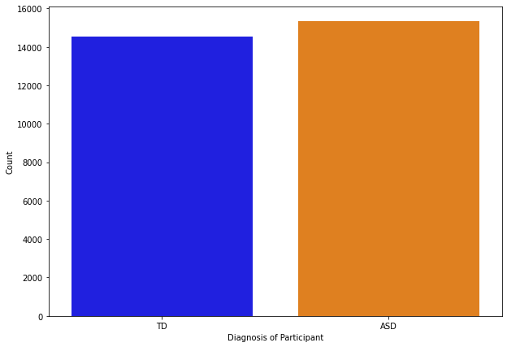
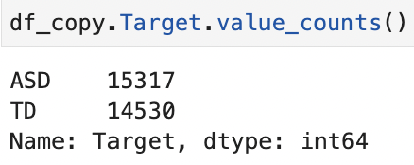
Target Evaluation
Binary classification of 1) typically developing (TD) or 2) autism spectrum disorder (ASD)
Notes:
My target data is in balance in the dataset so we can continue with this project ~15,000 datapoints for each category of diagnosis
TARGET
Binary classification of 1) typically developing (TD) or 2) autism spectrum disorder (ASD)
Categorical

Slide 21
Machine learning RECAP
Split Train and Test Data
Testing data
https://www.sciencedirect.com/science/article/abs/pii/B9780128212295000057
Notes:
Quick reminder: we have identified the features we will use and so we can now move onto splitting and training our dataset.

Slide 22
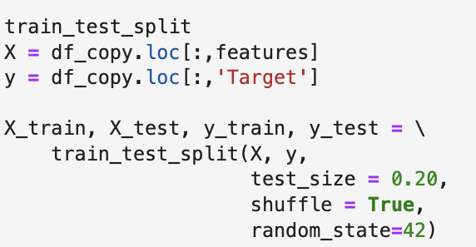
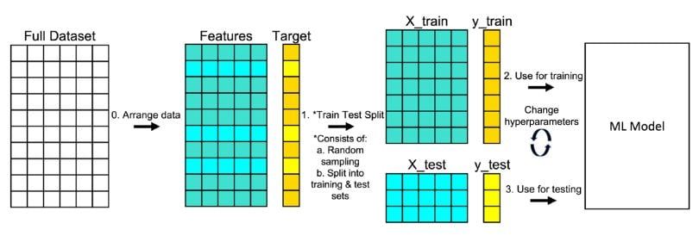
Dataset test and train split
Split dataset into train and test using 80% of data for training and 20% for testing
Train dataset helps create the model
Test dataset helps test the accuracy of the model built
https://builtin.com/data-science/train-test-split
Notes:
For this model, I chose to split the dataset into an 80% train and 20% test subset. 80% of the data is used to help create the model and 20% is used to test the model’s accuracy.

Slide 23
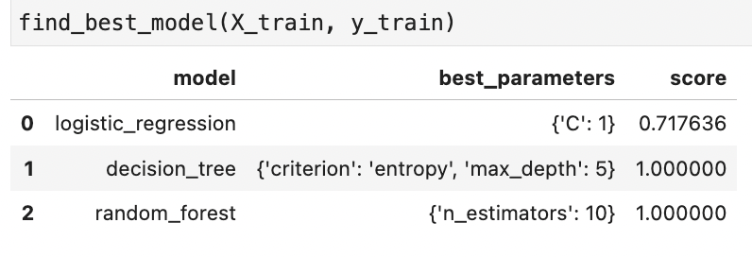
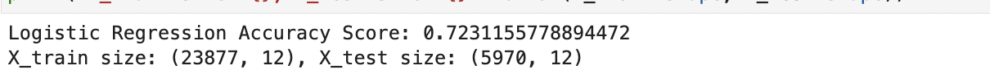
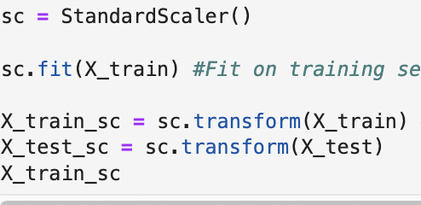
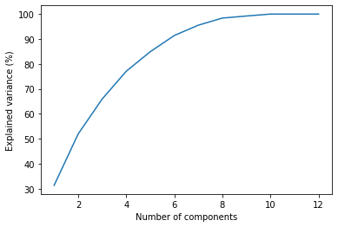
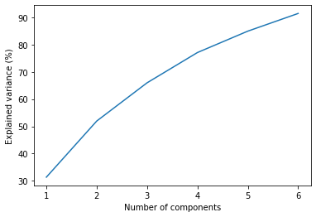
Model selection: Logistic Regression
Using GridSearchCV from sklearn kit to find best model from a logistic regression model, decision tree model and a random forest model.
Scale the model using Standard Scaler
Perform Principal Component Analysis to Reduce Dimensionality of dataset – 12 features >6 components.
Notes:
I ran a few programs from sklean kit to find the best model for this model prediction. I was already pretty wary as I knew I had a large dataset that could lead to overfitting. I selected to continue with combining PCA and Logistical Regression
Too many features could lead to overfitting which is what we see in this model. To overcome it, we will use PCA - Principal Component Analysis (PCA) to Reduce Dimensionality. In order to reduce the dimensionality of our data, a PCA analysis will be conducted on all 15 features in the dataframe.
PCA is a form of data visualizaiton and will be used in this project to reduce the dimensionality while minimising the loss of important information from our dataset so that I decrease the likelihood of overfitting our model.
I used an n_components = 0.85 in this PCA model so that it is prompted to select the minimum number of principal components so that 85% of the variance is retained in the model.
The point where the slope of the curve is clearly leveling off (the “elbow) indicates the number of factors that should be generated by the analysis.

Slide 24
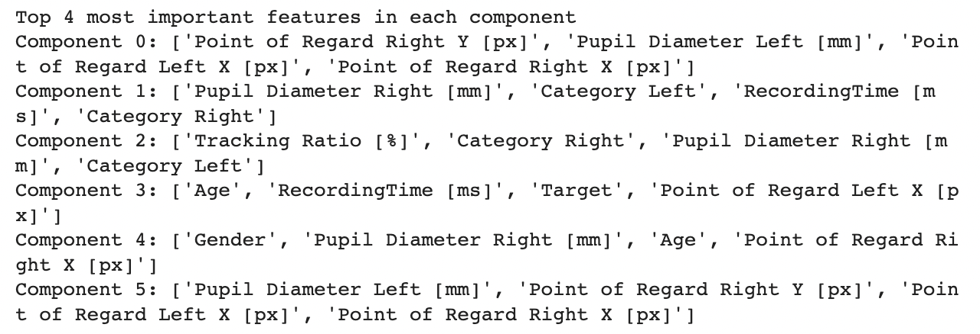
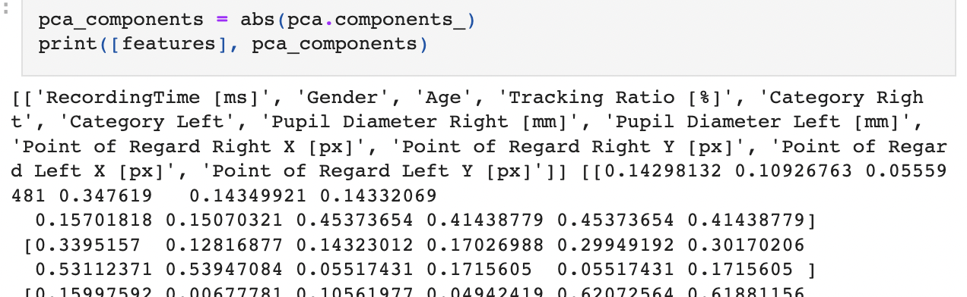
WHY PCA?
Pros
Reduces dimensionality in dataset while still maintaining the information needed from the dataset
Removes correlated features from the dataset
Reduced overfitting
Cons:
Need to scale the data before preforming PCA
Will still lose data
Notes:
The higher the magnitude of each feature, the higher importance of the feature. The above data is seen each of the 6 component, and each of the12 features.

Slide 25
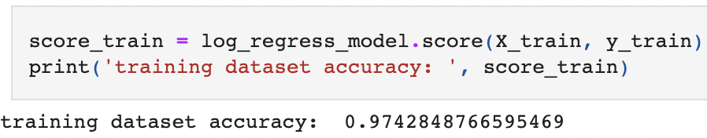
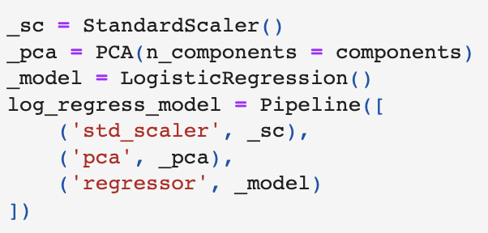
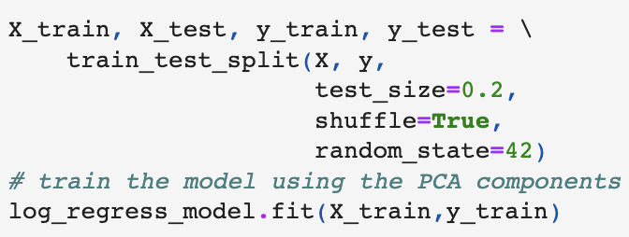
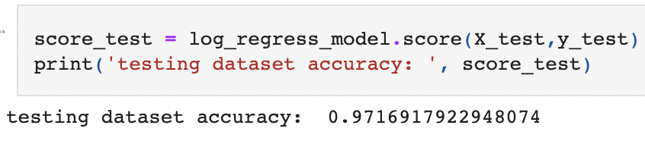
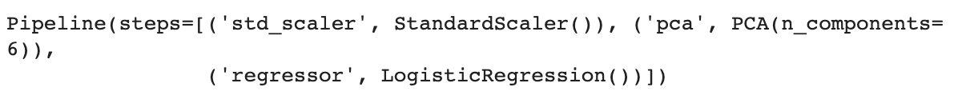
PCA + Logistic Regression model Pipeline

Slide 26
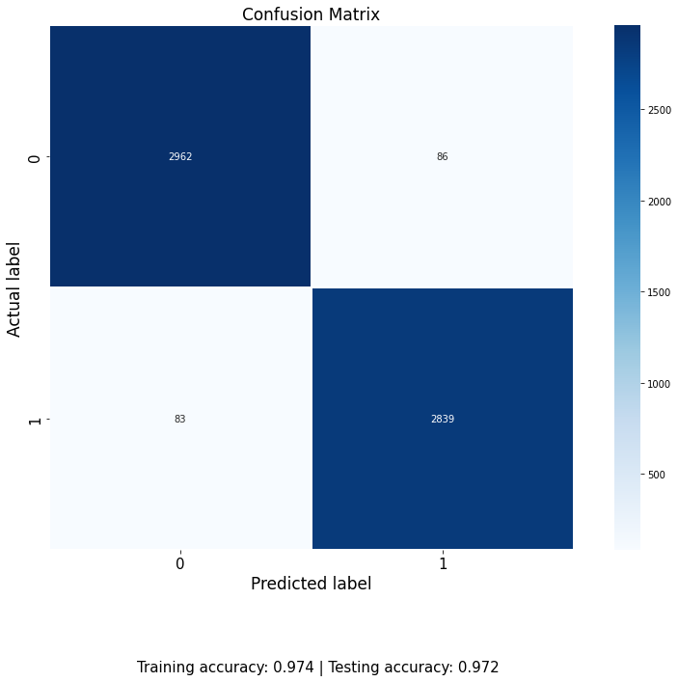
Overall summary
Too much information can lead to overfitting
Datasets with many features need to have a dimensionality reduction
PCA transforms features to principal components that retain important information
Data loss is inevitable and can affect the model’s accuracy
Notes:
Using PCA, I was able to reduce the features to 6 components to enhance the logistic regression machine learning model chosen to predict the autism diagnosis based on eye tracking data. As seen above, the training and testing accuracy are both over 97% correct which leads me to believe that there still may be overfitting occuring.
Additionally, it is important to note that this dataset was only a subset of a much larger dataset. There were many datapoints on eye tracking but not much variety in regard to the source of the data points, i.e. the participant dataset in this model was limited to 16. So while there were thousands of dataopints collected per participant, the variance in target was actually small.
To improve this model, I would need to re-evaluate my feature selection model.
Autism Diagnosis Relationship to Eye Tracking Synopsis
Age of diagnosis for autism in a child can be crucial to the child's development. This is because if a child is diagnosed earlier, there are interventions that can help the child with developmental milestones in behavior, speech, occupational and physical. This is especially true for children from low income households where families rely on a diagnosis to receive free or reduced cost therapies for their children.
To learn more about what kind of research is currently being funded by the NIH in this field, you can visit https://magazine.medlineplus.gov/article/eye-tracking-technology-holds-promise-for-earlier-autism-diagnosis.

Slide 27

challenges and proposed suggestion
Data Collection Process
Reduce changes in environment or routine
Collect data in the form of a longitudinal study
Data Processing and Analysis
Include all participant data collected
Review and prep csv file before loading into python to improve lag time for big file of data
Learn more about the concept of eye tracking
Notes:
Neurodivergent children tend to be more responsive in environments that they are comfortable
Take particiants to study location prior to conducting data collection
Bring equipment to home/school/etc
I only chose 1 CSV file out of 25 due to the size of the dataset. In theory we’d want to use all the datapoints collected – HOWEVER, this also led to an OVERFITTING issue as we saw in the previous slides. I believe that even if I were to have compiled all 25 csv files and worked with the full 59 participant dataset, I still would have had an overfitting issue because the

Slide 28
References
Spitzer RL, Siegel B. The DSM-III-R field trial of pervasive developmental disorders. J Am Acad Child Adolesc Psychiatry. 1990 Nov;29(6):855-62. doi: 10.1097/00004583-199011000-00003. PMID: 2273011.
Cilia, Federica; Carette, Romuald; Elbattah, Mahmoud; Guérin, Jean-Luc; Dequen, Gilles (2022): Eye-Tracking Dataset to Support the Research on Autism Spectrum Disorder. figshare. Dataset. https://doi.org/10.6084/m9.figshare.20113592.v1
https://pubmed.ncbi.nlm.nih.gov/2273011/
https://eyeware.tech/blog/what-is-eye-tracking/
https://www.crossrivertherapy.com/autism/wheel
https://www.cdc.gov/mmwr/volumes/72/ss/ss7202a1.htm?s_cid=ss7202a1_w
https://builtin.com/data-science/train-test-split
https://autismsociety.org/autism-acceptance-month/
https://www.sciencedirect.com/science/article/abs/pii/B9780128212295000057
https://magazine.medlineplus.gov/article/eye-tracking-technology-holds-promise-for-earlier-autism-diagnosis

Slide 29

Questions?
https://github.com/crubalcava/ASD_TD_EyeTracking_Predictions
Notes:
How to make this model better:
Take the AVERAGE of the pupil dialation or point of regard for each participant during each of their sessions and use the AVERAGE data to create a prediction model.

Slide 30

Thank you

